Slide 1

Task catalyst
Oral Presentation 2 – Software Demo
Notes:
NOTE: Want a different image on this slide? Select the picture and delete it. Now click the Pictures icon in the placeholder to insert your own image.

Slide 2

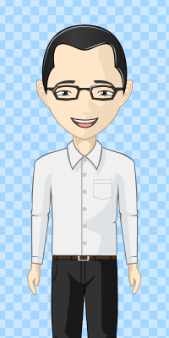
Meet John
Profile
Name: | John
Occupation: | Software Engineer
Hobbies: | Doing programming
Nickname: | Keyboard warrior

Slide 3



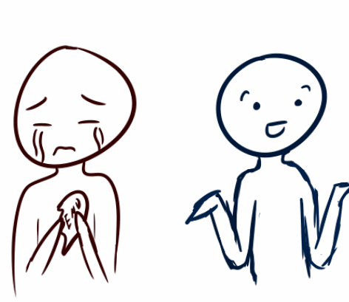
John’s Lifestyle
Family

Slide 4
How does John manage his time?

Slide 5


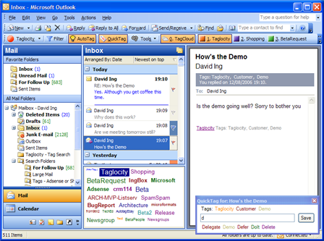
How does John manage his time?
Complete Project Demo
Meeting tomorrow 12pm
Meet David Ing tomorrow

Slide 6
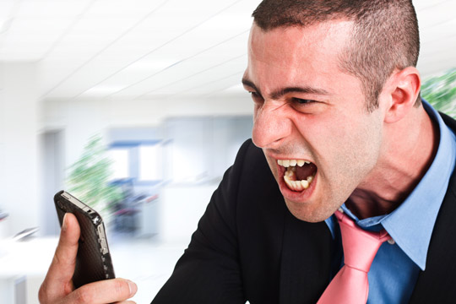

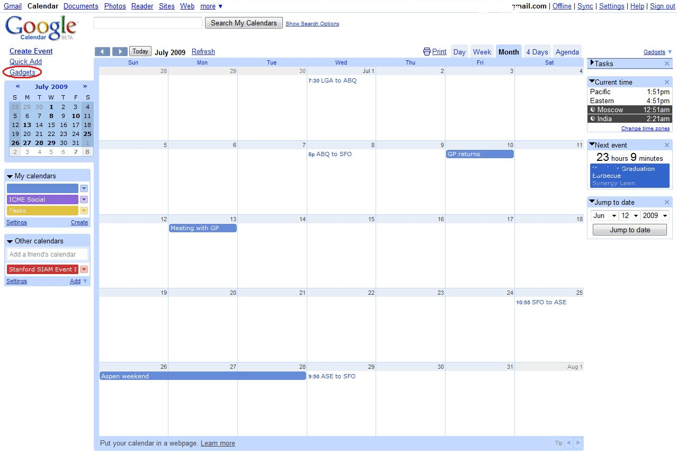

How does John manage his time?

Slide 7


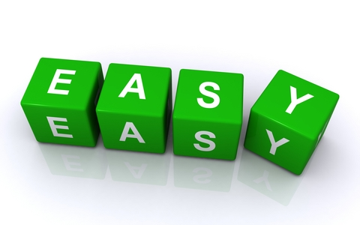
What he’s looking for?
Meet David Ing tomorrow
Accessible.
Powerful.

Slide 8
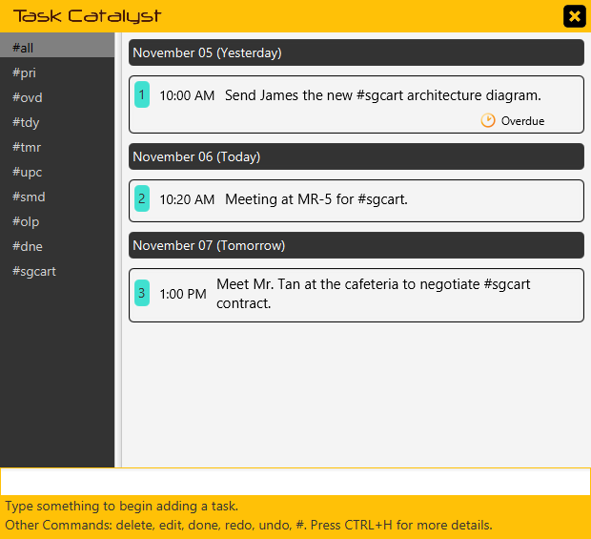
Finally…
Powerful.
Accessible.

Slide 9
Personal experience

Slide 10
Personal experience

Slide 11

Personal experience

Slide 12

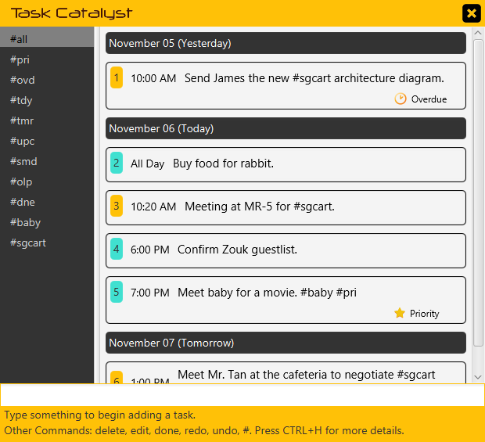
Personal experience

Slide 13

Personal experience

Slide 14


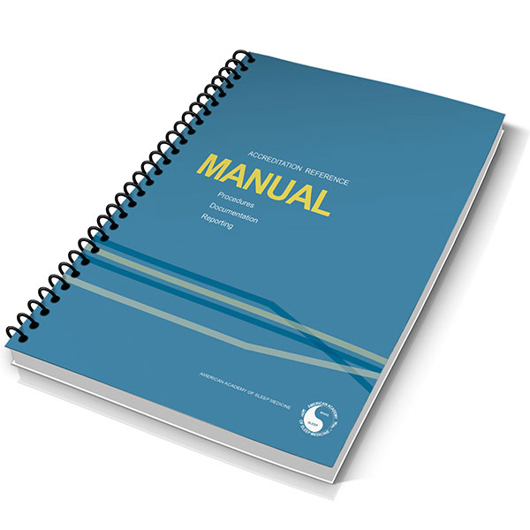

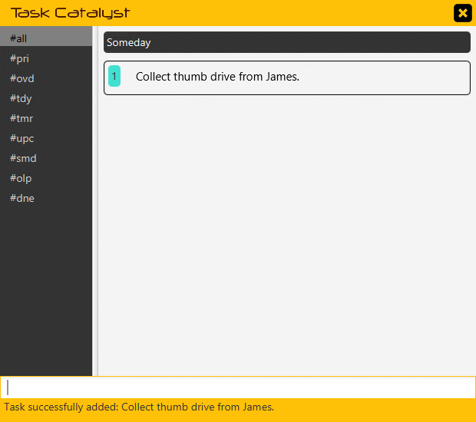
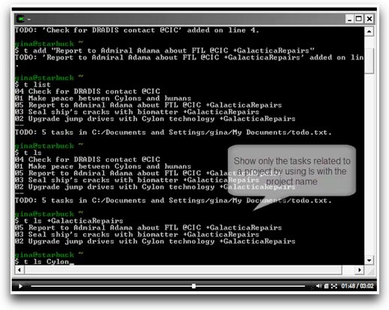
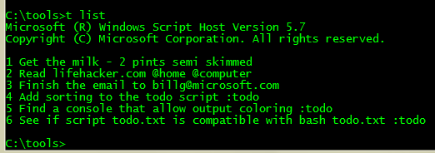
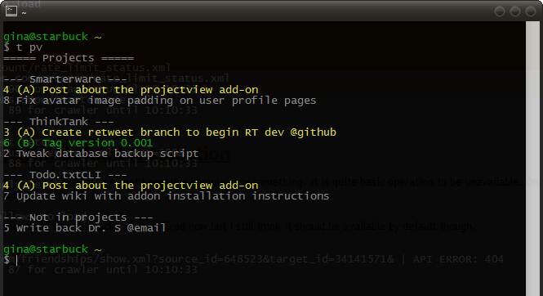
User Friendly and Intuitive
User Manuals
Cryptic Commands

Slide 15
User Friendly and Intuitive
Task Catalyst Expert

Slide 16
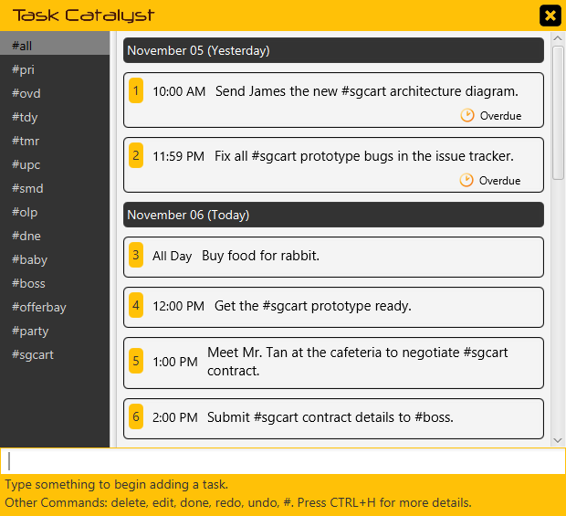
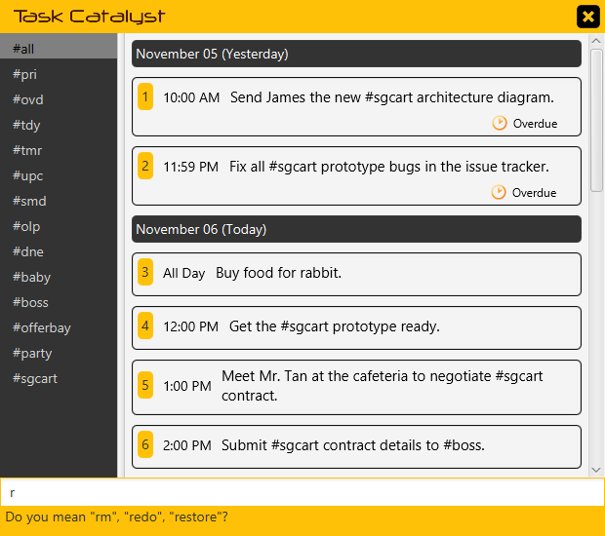
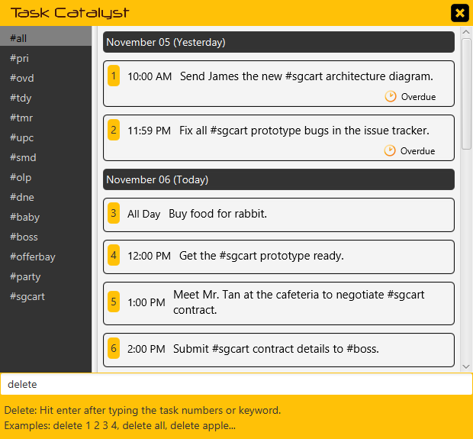
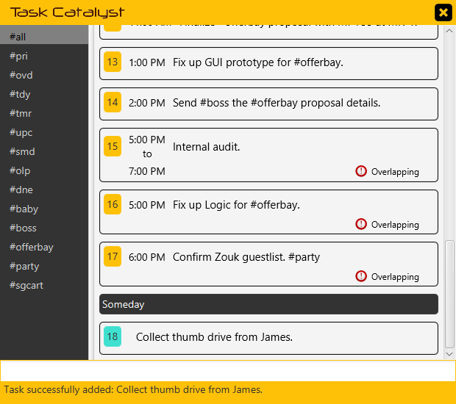
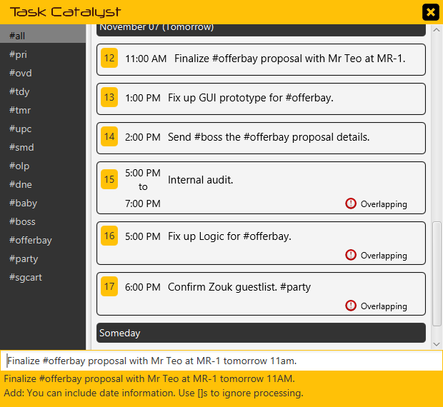
User Friendly and Intuitive
Friendly Prompts
Partial Command Hints
Command Guide
Instant Command Feedback
Live Task Preview

Slide 17
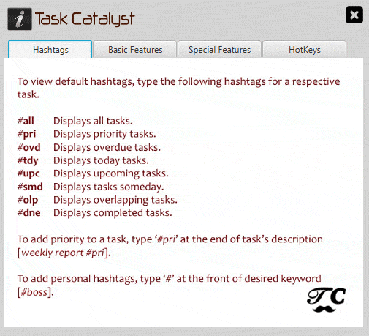
User Friendly and Intuitive
Comprehensive Quick Start Menu

Slide 18

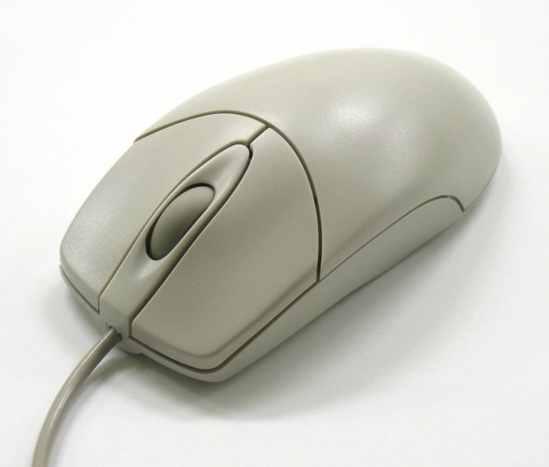
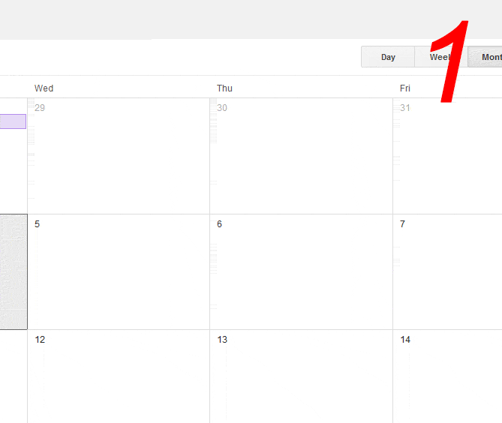
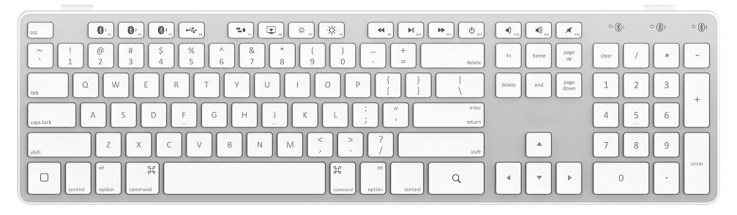
User Friendly and Intuitive

Slide 19

User Friendly and Intuitive
Manage your tasks using only the keyboard!

Slide 20
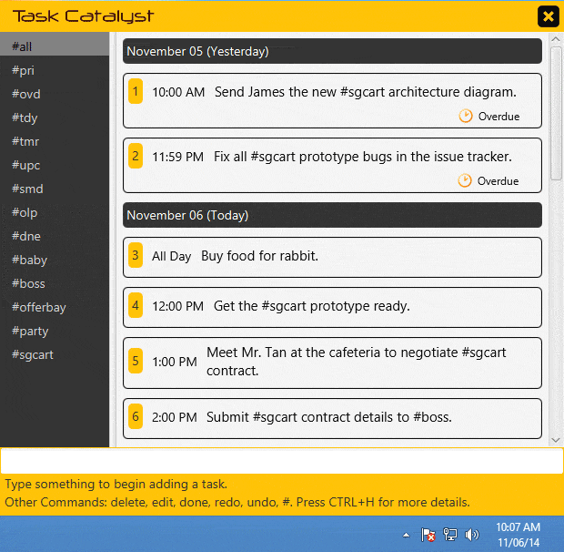
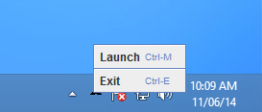
User Friendly and Intuitive
System Tray Hide/Restore
A full range of hotkeys at your disposal!

Slide 21




User Friendly and Intuitive

Slide 22
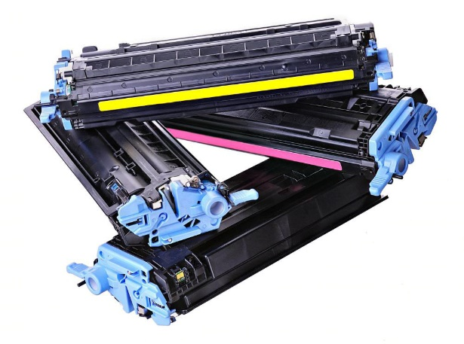
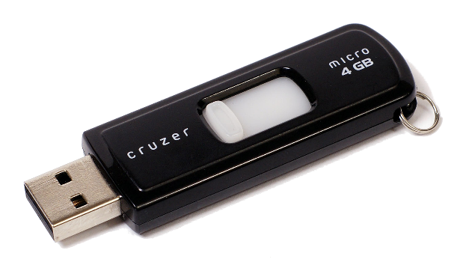
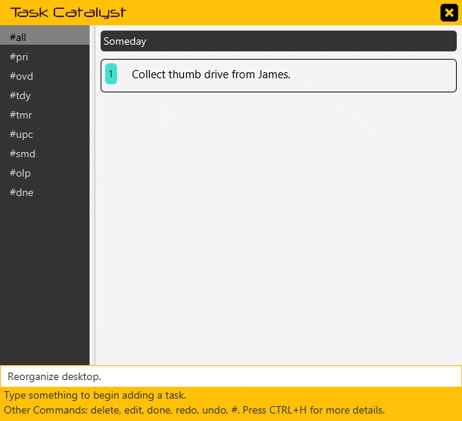
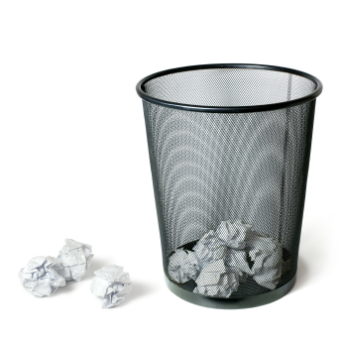
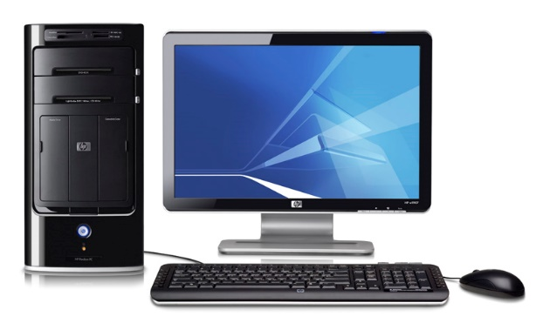
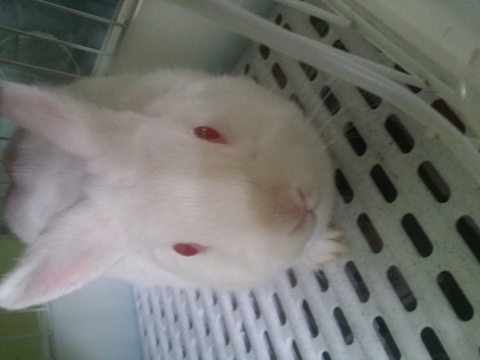
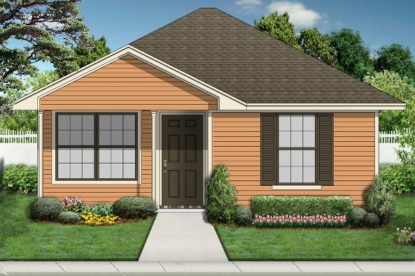
Simple yet Powerful

Slide 23

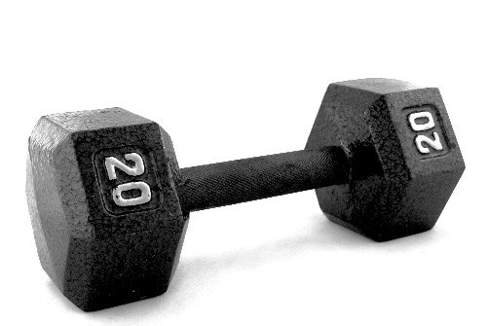
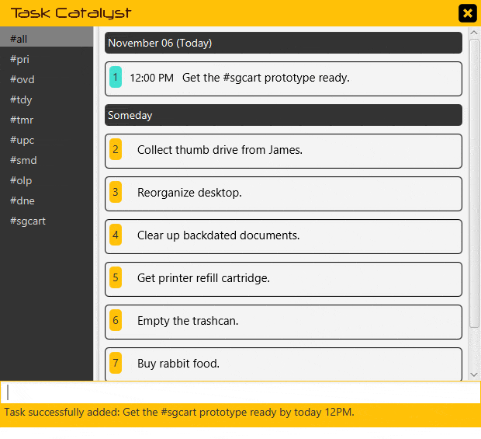
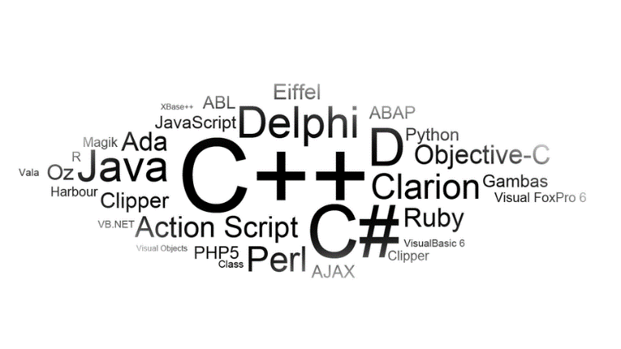
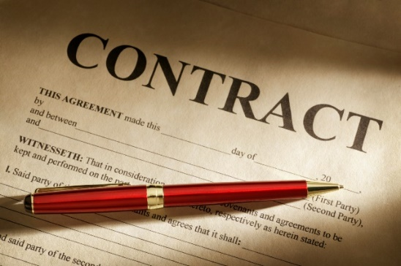
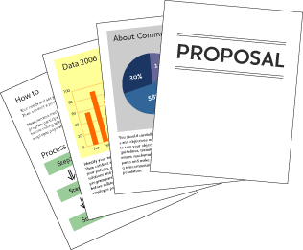

Simple yet Powerful

Slide 24
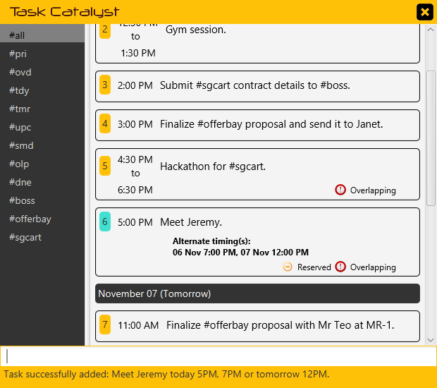
Simple yet Powerful
Meet my project client…
5PM Today
7PM Today
12PM Tomorrow
?

Slide 25
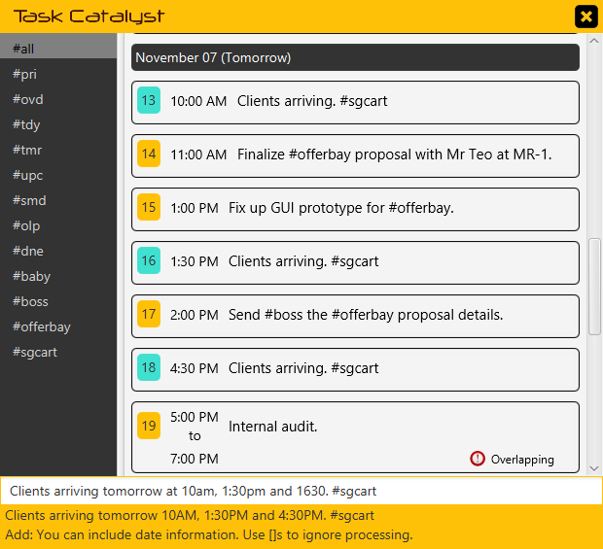
Simple yet Powerful
Clients arriving at…
10AM
1:30PM
4:30PM

Slide 26

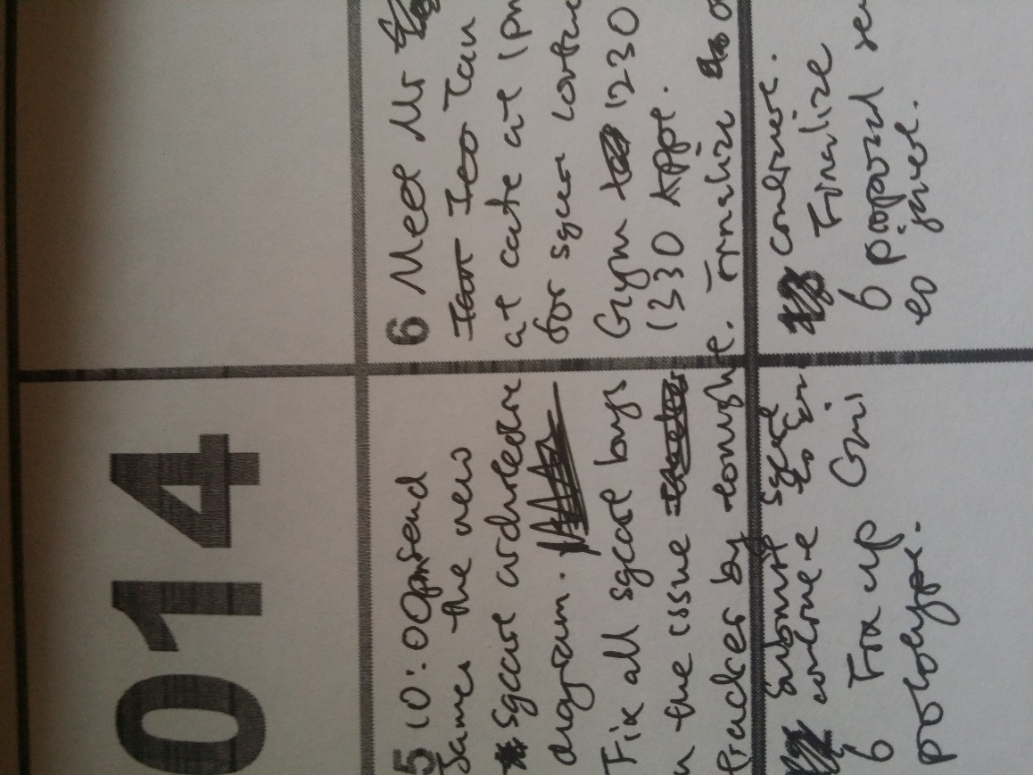
Simple yet Powerful
Task reassigned
Another mistake
Timing changed
Another mistake
Details changed
Date cancelled
Mistake

Slide 27
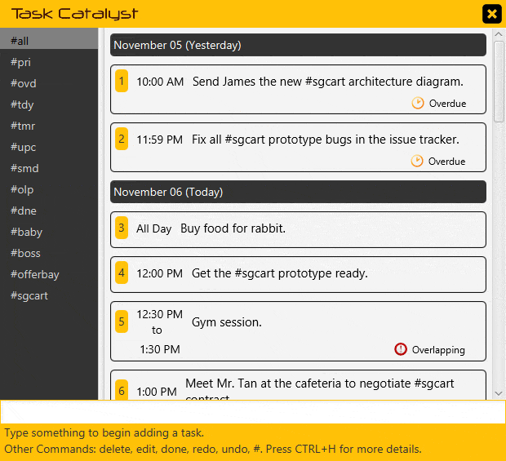
Simple yet Powerful
Your Magical Stationeries...
Edit
Delete
Undo
Redo

Slide 28
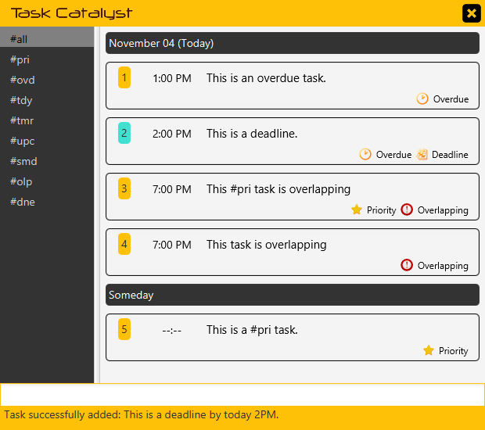
Simple yet Powerful
Direct
Your
attention
to the IMPORTANT.

Slide 29

Simple yet Powerful
All - #all
Priority - #pri
Overdue - #ovd
Today - #tdy
Tomorrow - #tmr
Upcoming - #upc
Someday - #smd
Overlapping - #olp
Done - #dne

Slide 30
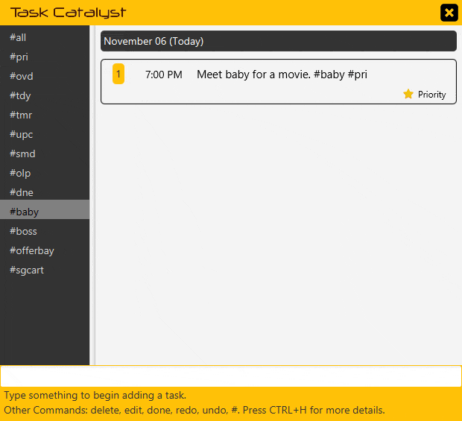
Simple yet Powerful
Organize your tasks
your way!

Slide 31
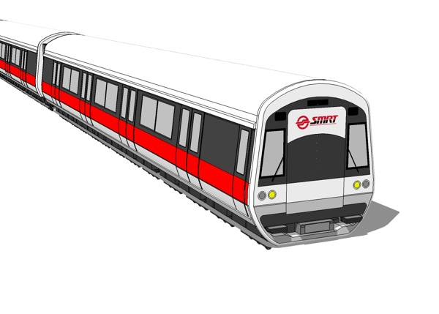

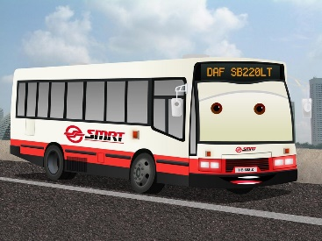


Accessible

Slide 32


Accessible

Slide 33
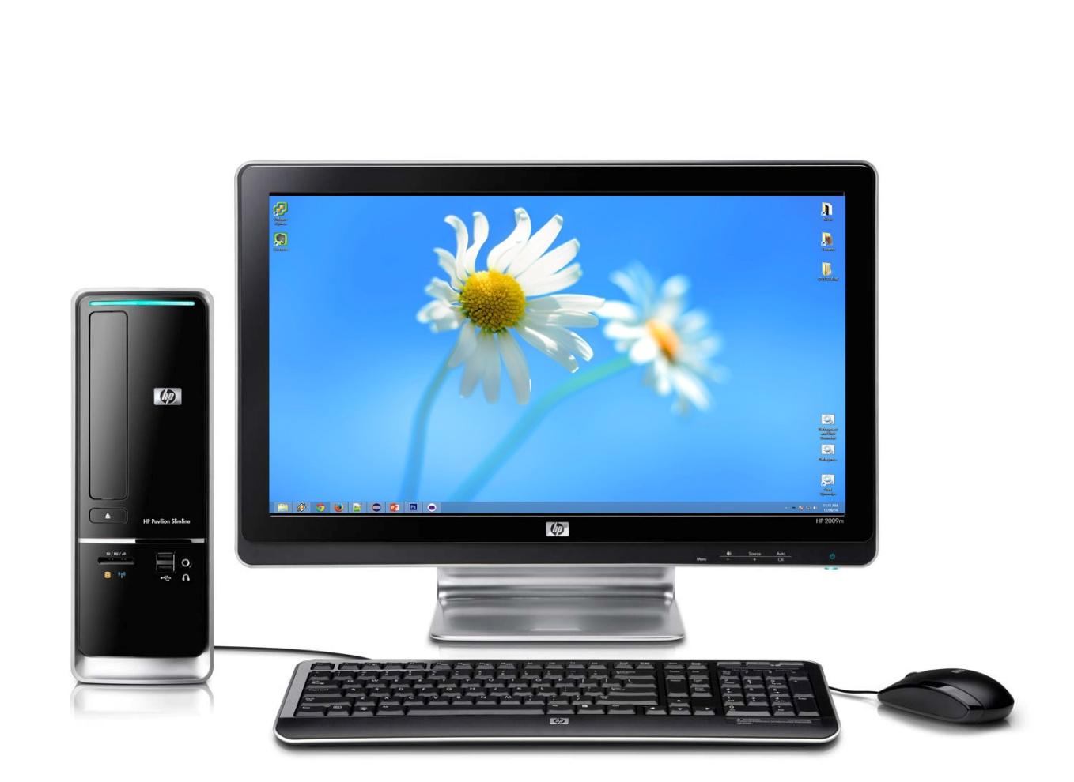

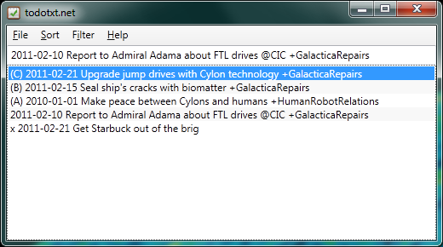
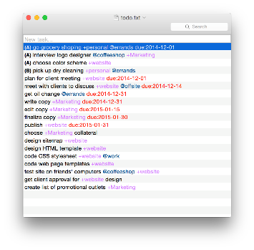
Accessible
At work…
At home…

Slide 34
Accessible
At work…
At home…

Slide 35
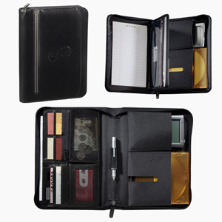
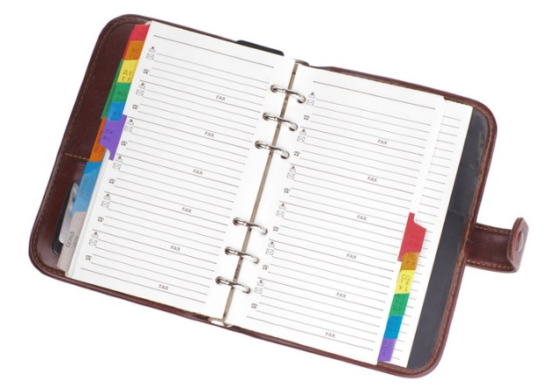

Accessible

Slide 36
SOFTWARE DEMONSTRATION

